Slide 1
ARTIFICIAL INTELLIGENCE IN PET/CT
CHRISTOS MANGLARIS
DIMITRIS KARATASIOS

Slide 2
What is PET and why is so important?
How is PET/CT different from traditional PET imaging?
PET (positron emission tomography) is an advanced imaging device used in nuclear medicine that is used in neurology, oncology, and cardiology. PET has several clinical applications as a noninvasive technology, including cancer screening, tumor detection, tumor staging, and therapy response and outcome monitoring. A small amount of a radioactive tracer, such as 18F-fluorodeoxyglucose, is injected into a patient for a PET scan (FDG). The positrons it emits are almost instantly destroyed in the patient's body, resulting in the emission of paired photons. PET scans are safer for patients because they utilize less radioactive tracer, which saves money and reduces danger.
Today, most of the Positron Emission Tomography (PET) scanners you find in hospitals, or delivered via mobile imaging, are actually PET/CT cameras. Modern PET/CT scanners combine both PET and Computed Tomography (CT) scans almost simultaneously to provide a greater amount of clinical data to assist in the diagnosis process. A PET/CT scan includes two parts: a PET scan and a CT scan. The CT portion of the scan produces a 3-D image that shows a patient’s anatomy. The PET scan demonstrates function and what’s occurring on a cellular level. The PET scan is unique because it images the radiation emitted from the patient while the CT records anatomical x-rays, showing the same area from another perspective.

Slide 3
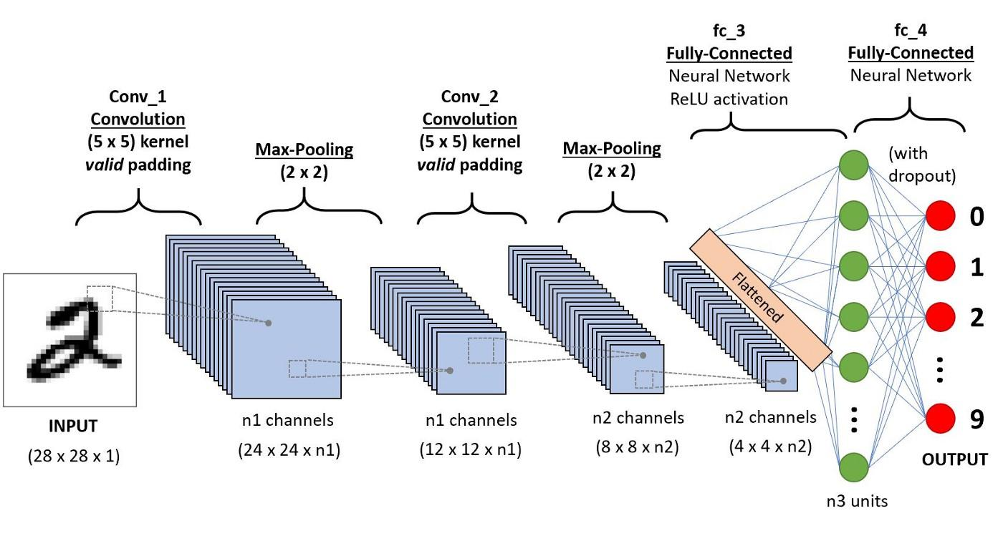
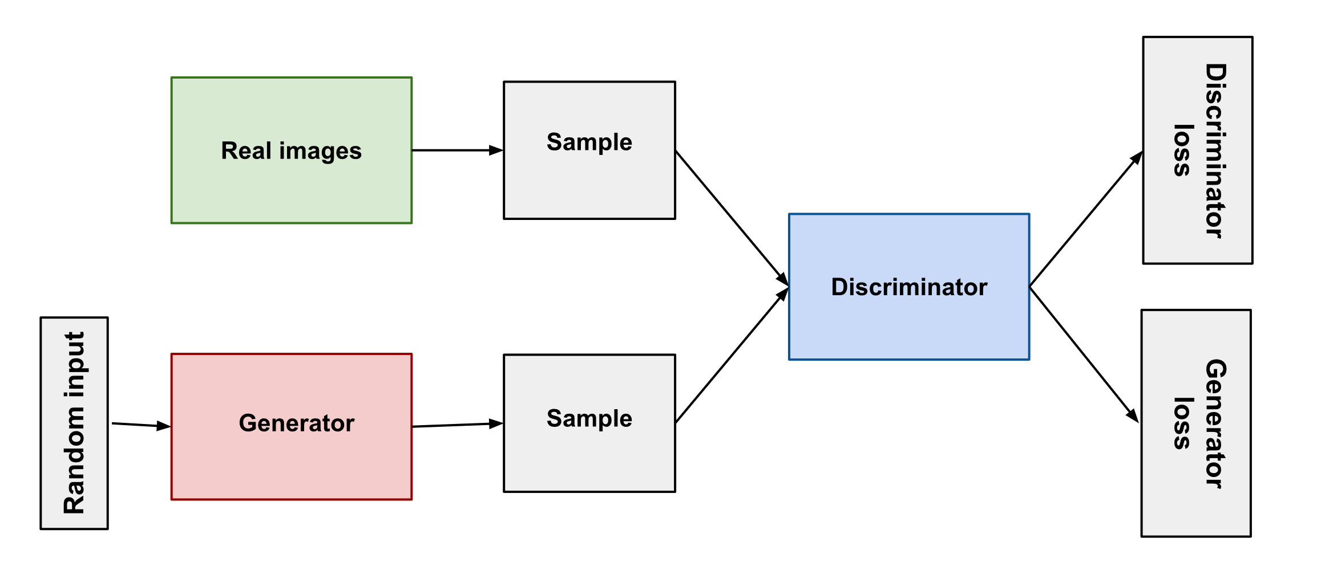
AI Techniques most used in PET/CT field (1/2)
Convolutional Neural Networks (CNN) for image segmentation
Generative Adversarial Networks (GANs) for image detection and classification

Slide 4
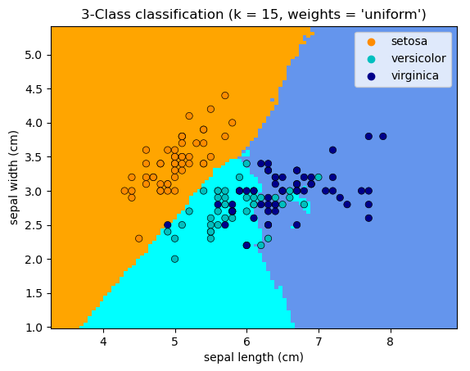
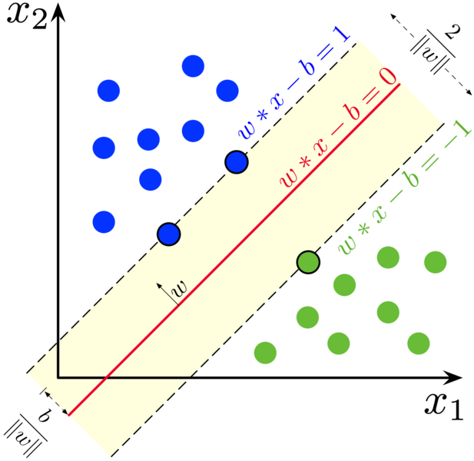
AI Techniques most used in PET/CT field (2/2)
k-Nearest Neighbors (KNN) estimators for matching similar image features.
Support Vector Machines (SVM) for multi-modal image registration.

Slide 5
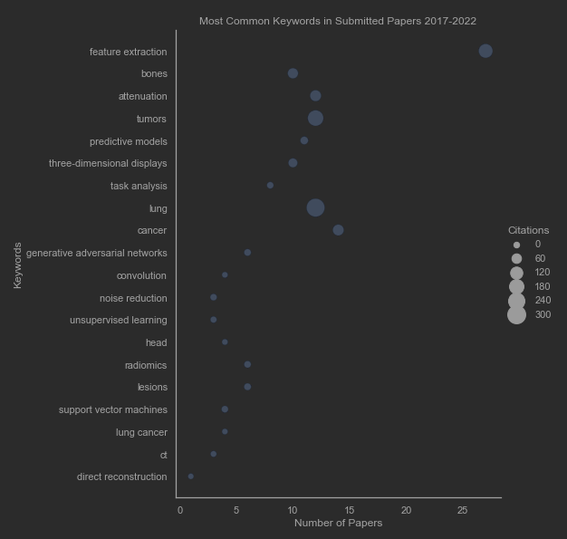
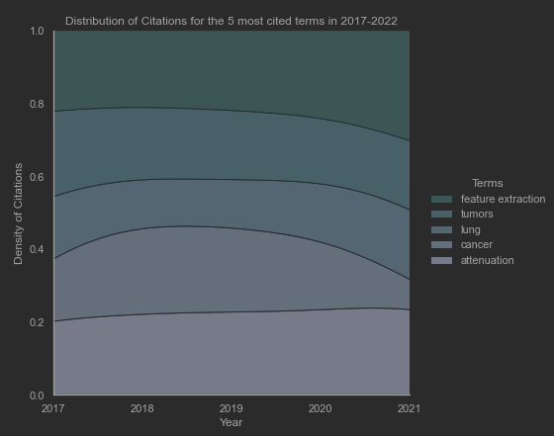
Review Methodology
Search in IEEEXplore and Nature Databases
Keyword Analysis of 125 Papers between 2017-2022
Review of the 30 most cited papers

Slide 6
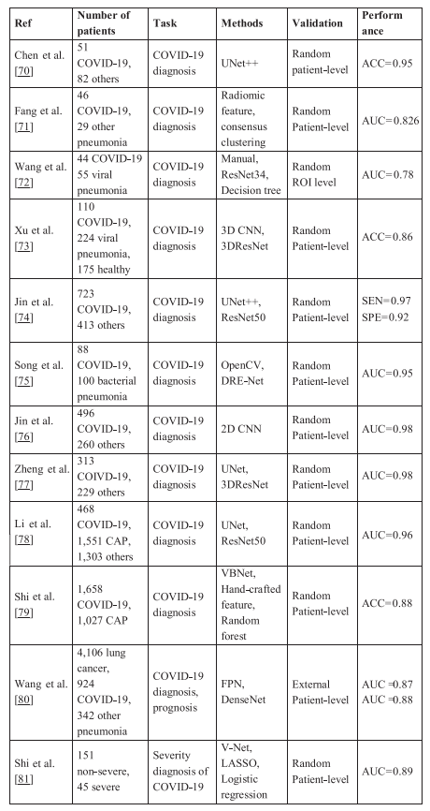
Image Classification and Segmentation
COVID-19 Diagnosis from CT Images using weakly supervised deep learning strategies.
Use of Convolutional Neural Networks (CNN) for image segmentation of tumors in PET-CT images.
Use of Generative Adversarial Networks (GNN) to detect and classify lymphoma in PET-CT images.
Deep learning along radiomics for the detection of squamous cell carcinoma of the neck and head in PET-CT images.
Notes:
IMAGE CLASSIFICATION 🡪 is a subdomain of computer vision that deals with categorizing and labelling images
IMAGE SEGMENTATION 🡪 is the process of partitioning an image into multiple segments and assign a specific class to each
RADIOMICS 🡪 method of feature extraction from radiological images using data-characterization algorithms

Slide 7
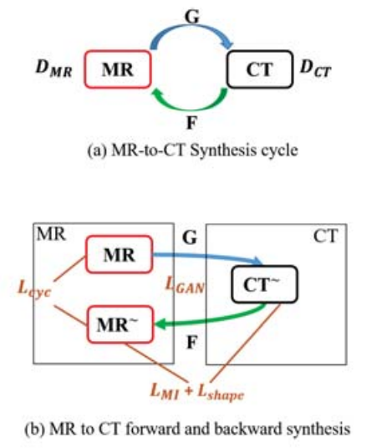
IMAGE RECONSTRUCTION
Machine Learning techniques for the reconstruction of CT images instead of using filtered backprojection.

Slide 8
FUSION OF IMAGE MODALITIES
Fusion of PET-CT modalities using CNNs to create a fusion map containing the most useful modalities from each image to detect lung tumors.
Use of KNN estimators to match similar features and create a pseudo-CT image from MRI data
Use of GANs to fuse images between low and high resolution modalities (CT-PET, MRI-PET)
Multi-modal image registration from CT-PET images using Support Vector Machines (SVM).

Slide 9
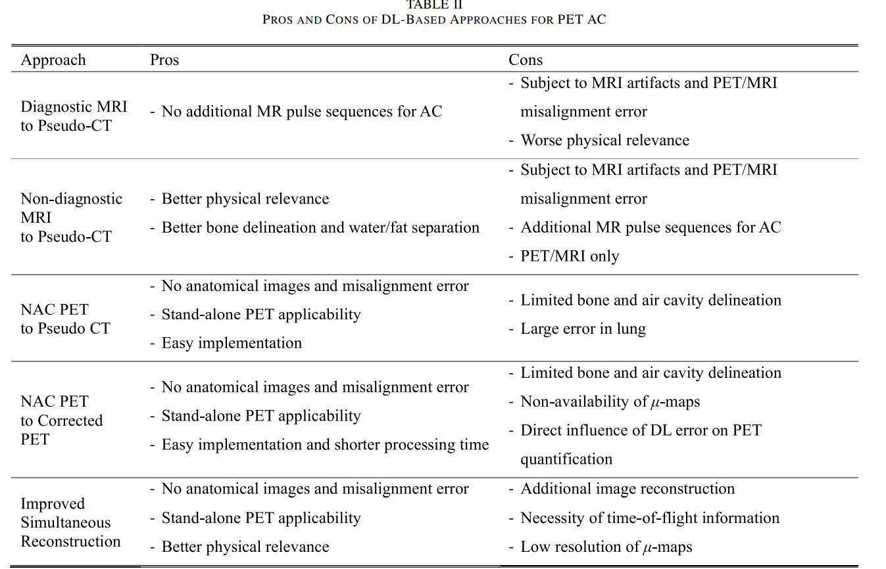
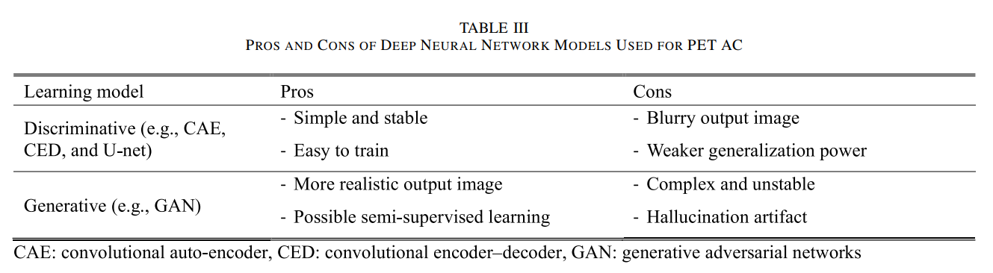
ATTENUATION CORRECTION
Correction of the attenuation present in PET-CT images using deep learning.

Slide 10
